Slide 1

EASTERN PHILOSOPHIES OF EDUCATION
Mustard Tigers
Adam, Bridget, Sean

Slide 2
Land Acknowledgement
Please join in me acknowledging that Thompson Rivers University is located on the unceded lands of Tk̓emlúps te Secwépemc within Secwepemcúl’ecw. The Secwépemc Nation has been stewards of this land since time immemorial, and we should support them in their continued efforts to care for their territory.

Slide 3
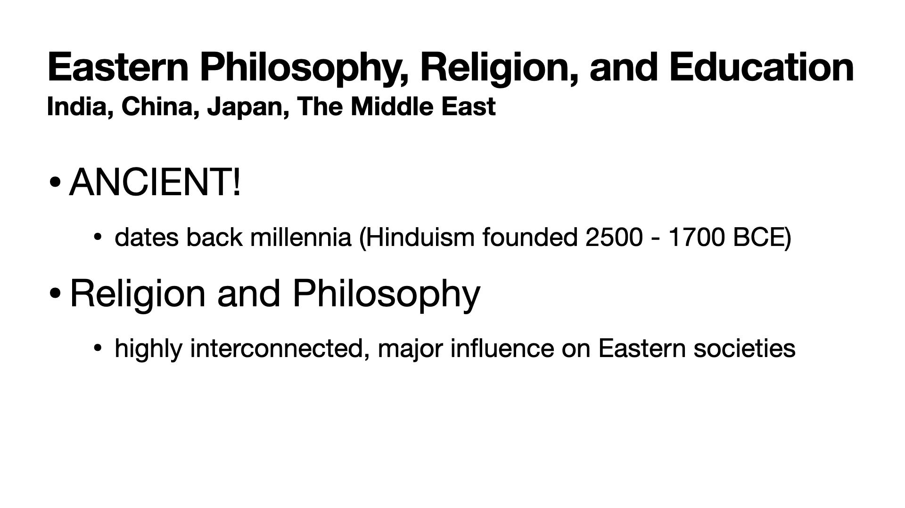

Slide 4
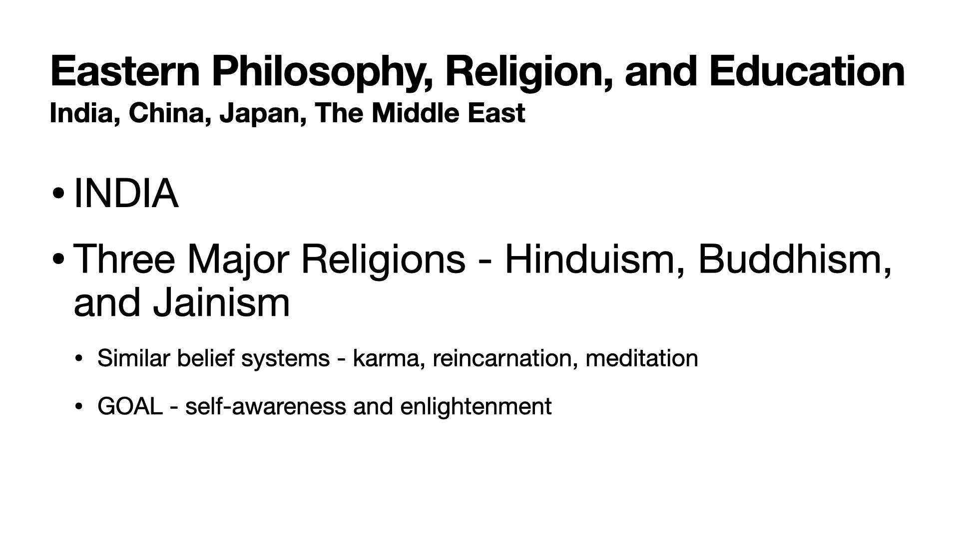

Slide 5
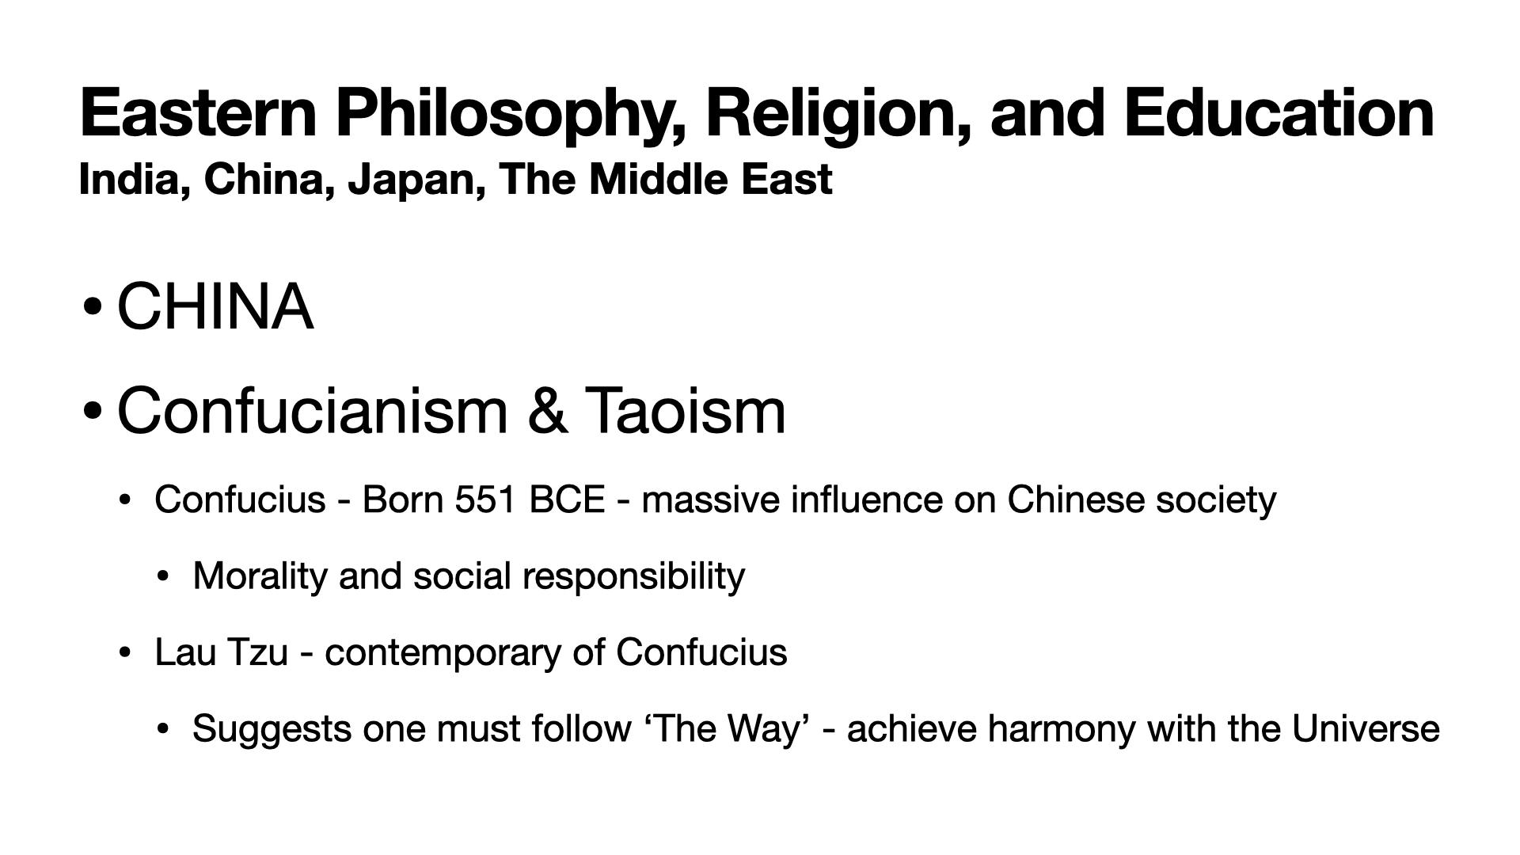

Slide 6
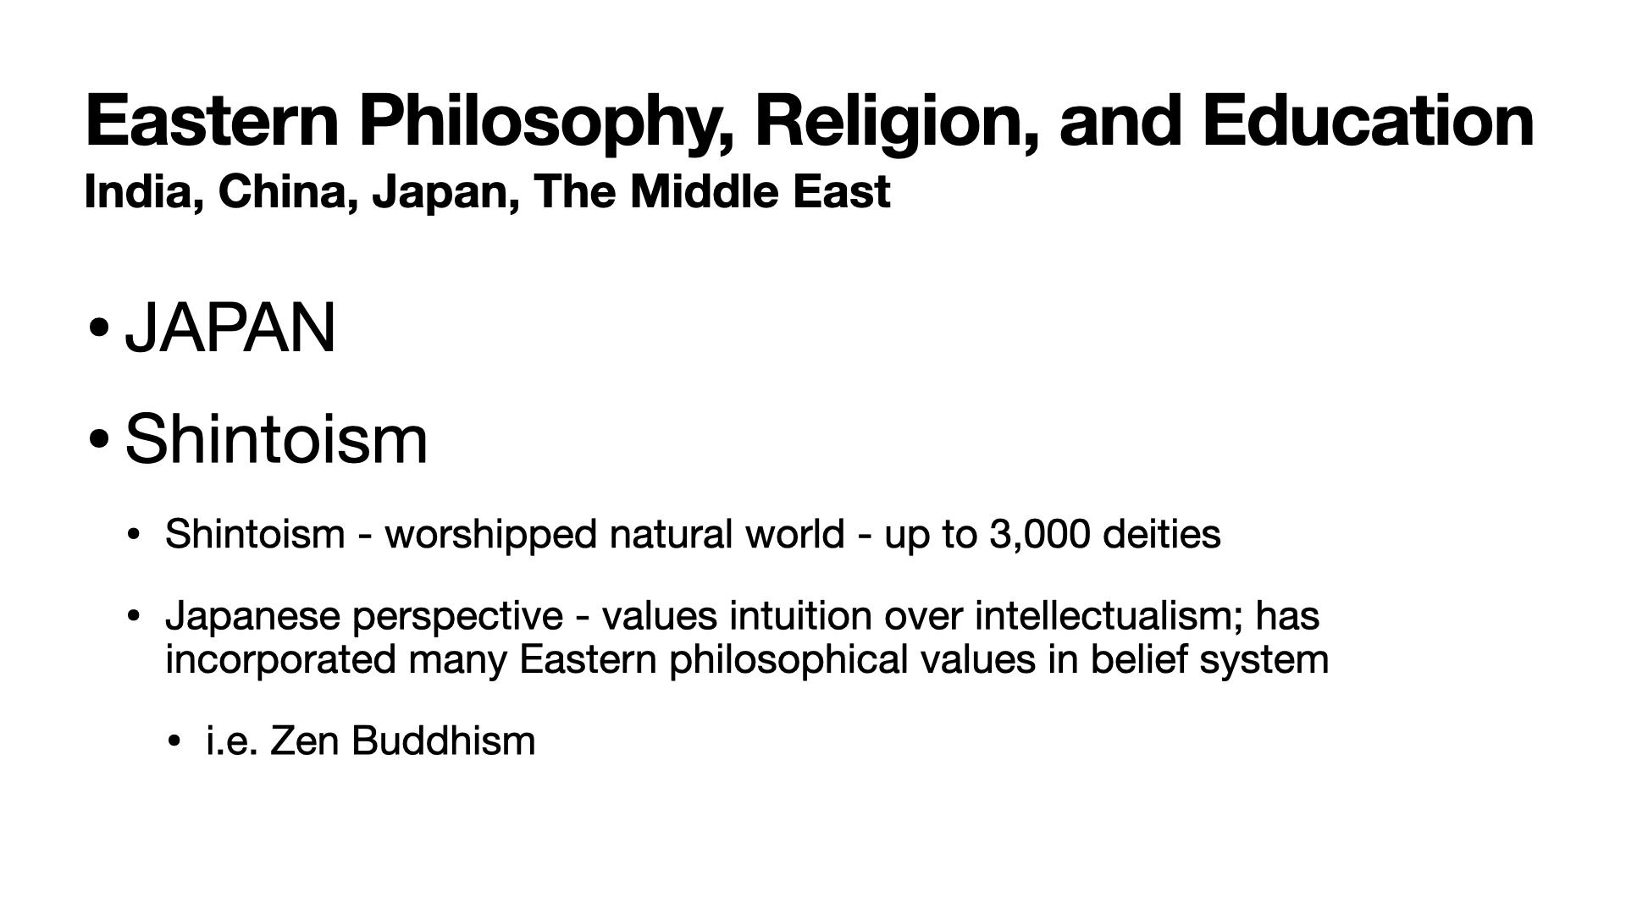

Slide 7
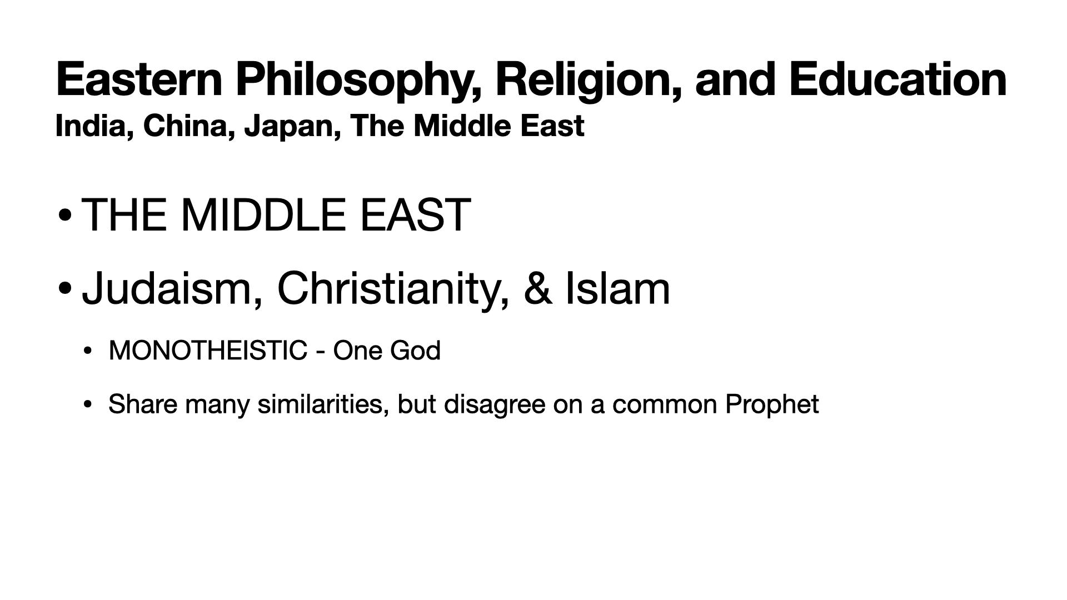

Slide 8
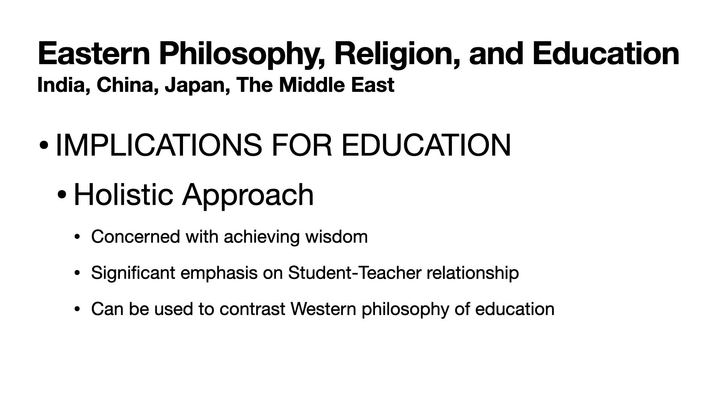

Slide 9
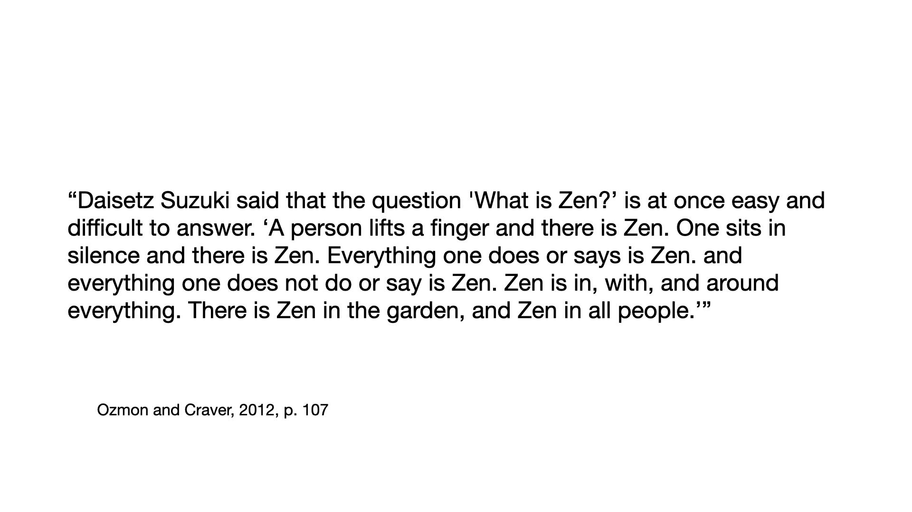

Slide 10
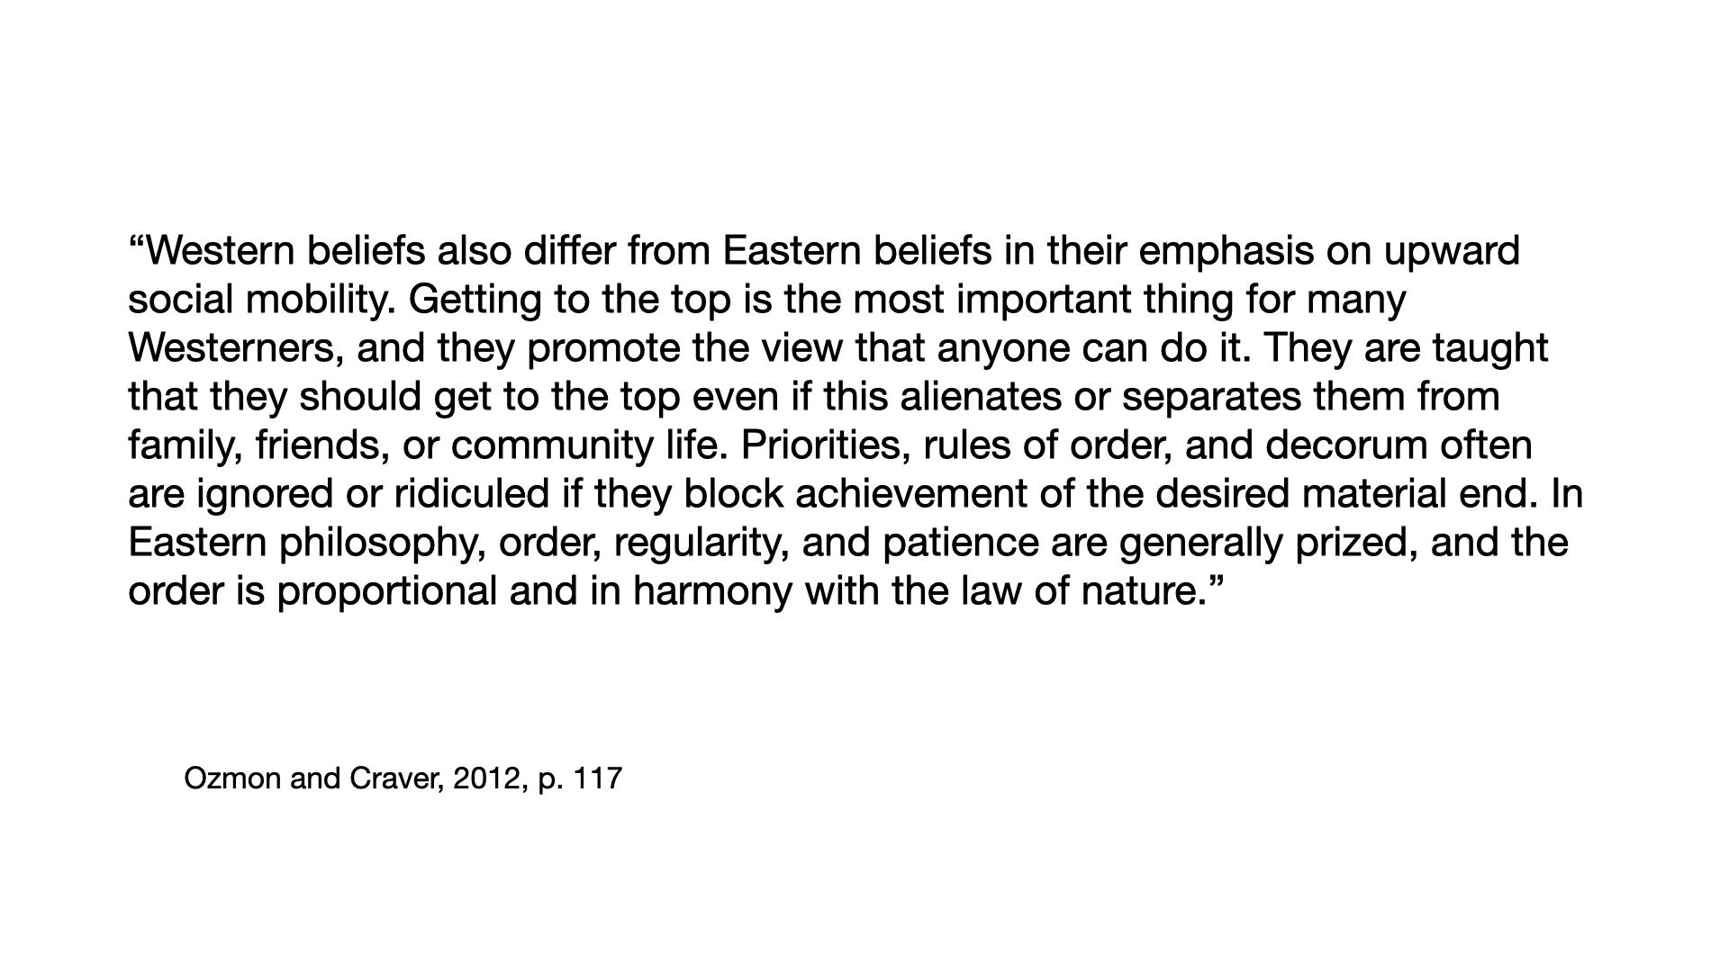

Slide 11
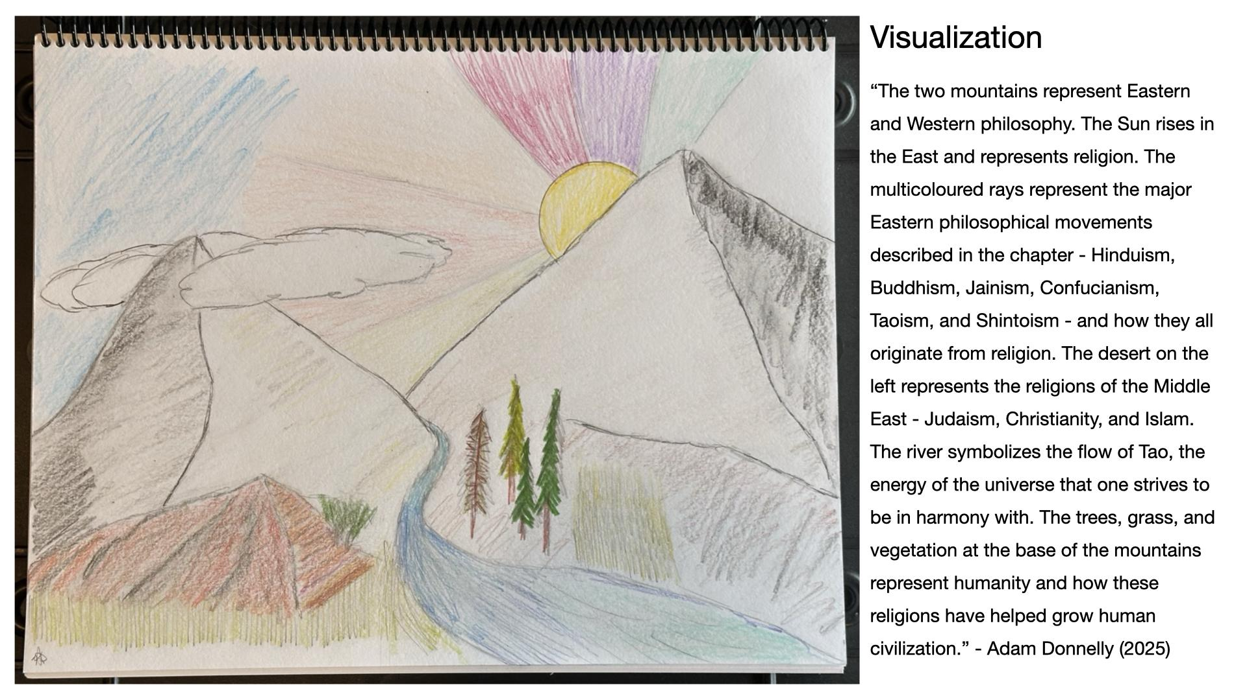

Slide 12

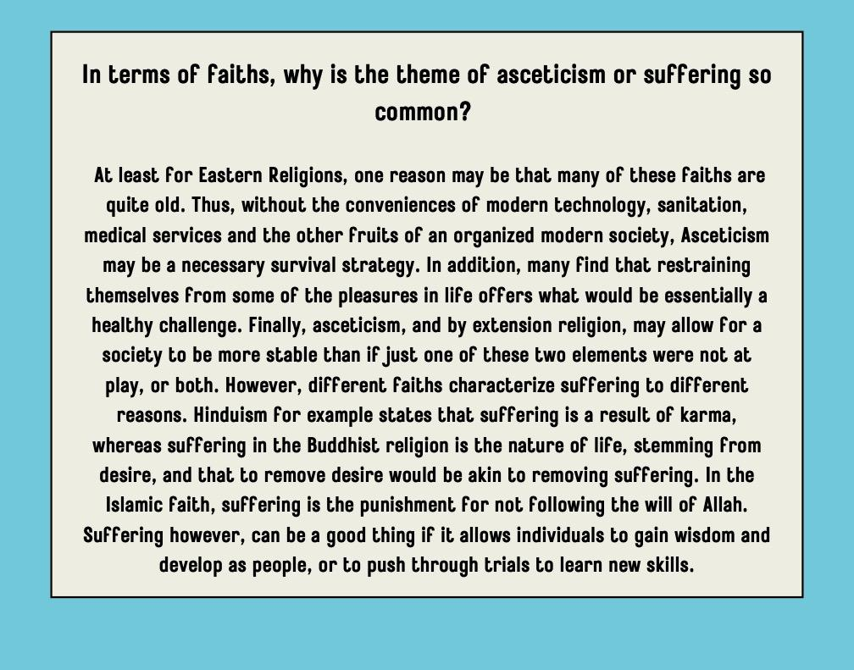
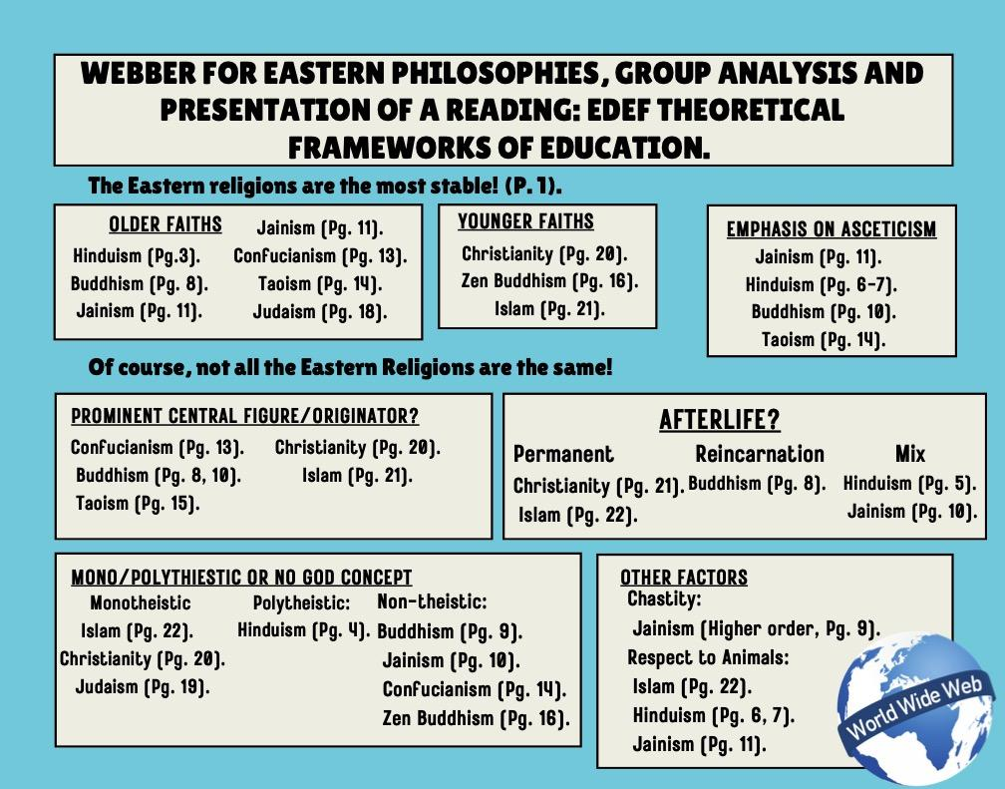

Slide 13
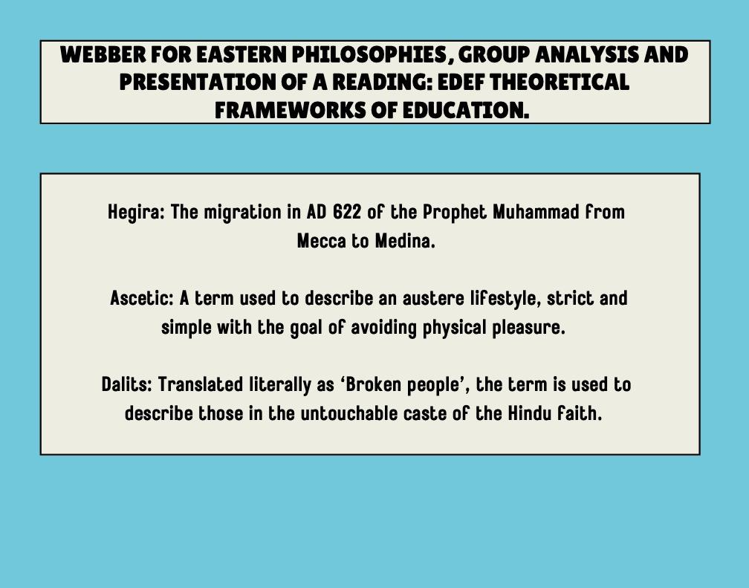

Slide 16



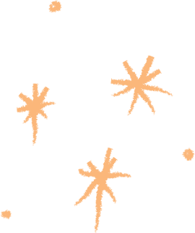




We use Eastern Philosophy Ideas in our therapy
These ideals can help people look at society in a more positive way.

Slide 17




Mindfulness
Mindfulness comes from Buddhism and is rooted in being present in the moment. We can acknowledge our feelings without judgement.

Slide 18


Balance
Balance is a huge part of many Asian cultures. The Yin Yang symbol is a perfect example. With this symbol comes the understanding that there is no good without the bad.

Slide 19


Acceptance
Acceptance including radical acceptance is a principal included in Buddhism, Taoism, Hinduism, and Jainism

Slide 20


Nature
Nature is a huge part of many Eastern teaches including Buddhism which teaches us that change is essential for growth just like the seasons

Slide 21


Inner Fufilment
Relying on inner fulfillment means focusing on internal sources of validation and contentment instead of relying on others

Slide 22


How to Use This in our Practice
  Teach our students to be mindful
  Live in the moment
  Let things go
  Connect to nature
  Accept the things you cannot change
  Grow your self regulation skills
  Practice self reflection

Slide 23



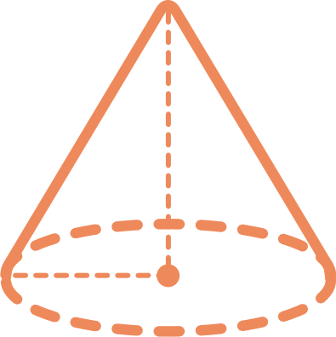




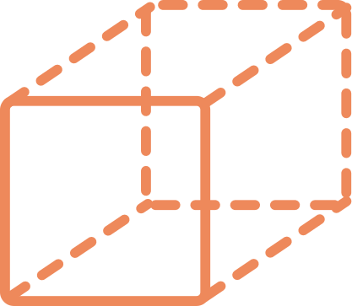
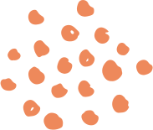

Activity
Acceptance and inner fulfillment

Slide 24

Things I Cannot Control
Things I can Control
Today I will not stress about the things I cannot control

Slide 25
